Slide 1
Chapter 10:
Unsupervised Learning
10.3 Clustering Methods
Team 12: Cole Combs, Thomas Fergus, Vivian Li, Will Shiflett

Slide 2
Review: Supervised vs. Unsupervised Learning
Supervised Learning
Allows us to check our work
We can see how well our predictive model (linear, LDA, etc.) predicts the response Y on observations not used in fitting our model
Unsupervised Learning
Often performed as part of exploratory data analysis
We have no associated response variable Y, so cannot make predictions
We CAN seek to understand the relationships between variables and relationships between observations

Slide 3
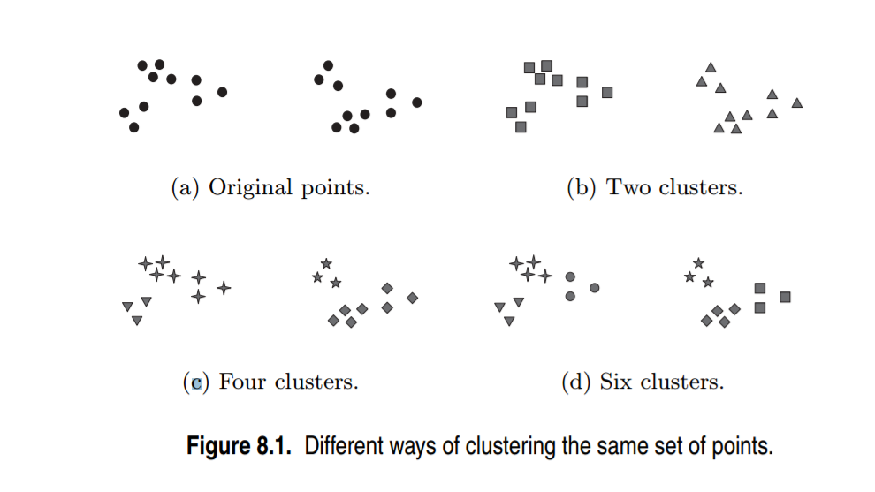
Cluster Analysis
Goal: “to ascertain, on the basis of x1, …, xn, whether the observations fall into relatively distinct groups”
AKA find similar items, put them together
Definition: Clustering is a set of techniques for finding subgroups, or clusters, in a dataset
Dividing observations into homogenous and distinct groups
Why is Cluster Analysis Considered Unsupervised Learning?

Slide 4
Types of Data in Cluster Analysis
Numeric & Interval Scaled Variables
These variables are continuous of a linear scale
Before applying distance measured, need to standardize variables
R: scale() function
Variations of standardization:
v = ( x – m )/s or v = ( x – m )/ s
where m is the mean, s is the standard deviation, s is the mean absolute deviation
Notes:
Use s, the mean absolute deviation, to produce distance measures that are more robust to outliers (without removing them)

Slide 5
Types of Data in Cluster Analysis
Categoric Variables
A generalization of the binary variable in that it can take more than 2 levels, e.g., red, yellow, blue, green
Method 1: Simple Matching
d( i , j) = (n - p) / n
Where p is the number of matched categorical variables and n is the total number of variables
Method 2: Convert each level into a binary variable (the presence or absence of a red), creating many new binary variables

Slide 6
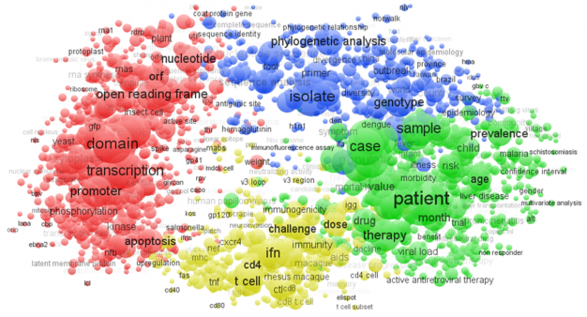
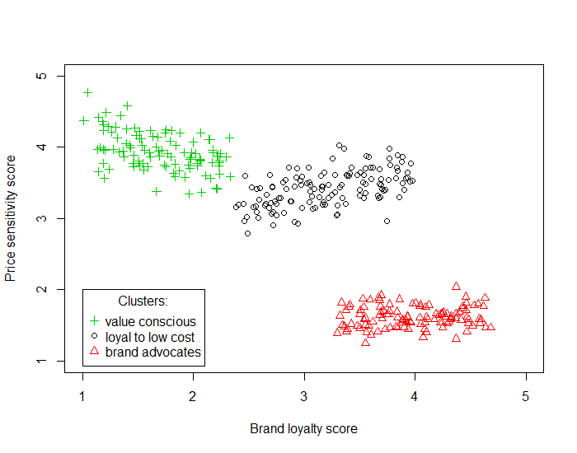
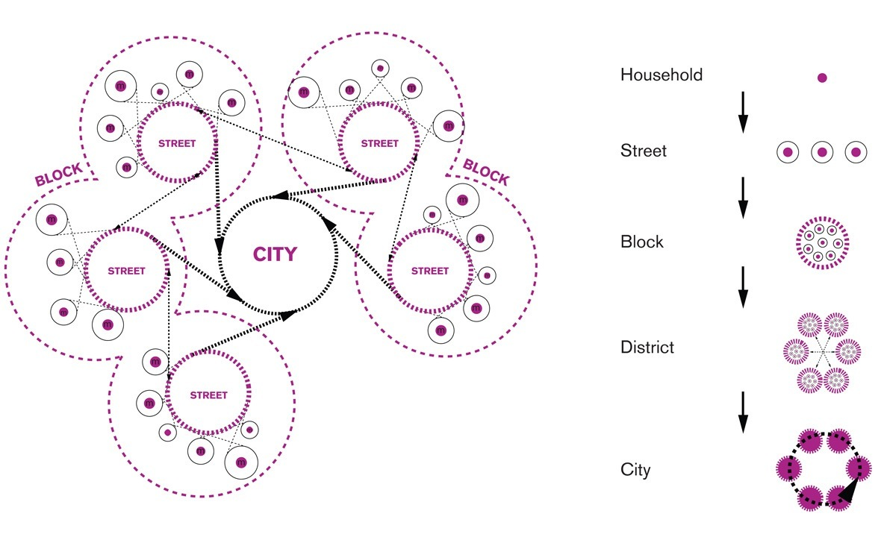
Real World Cluster Analysis
Psychology and Medicine
Sales Segmentation
City Planning
Notes:
Sales Segmentation: clustering can tell you what types of customers buy what products (by defining customers into groups)
City Planning - identifying groups of houses according to their house type, value, and geographical location
https://www.rita.dot.gov/bts/sites/rita.dot.gov.bts/files/publications/journal_of_transportation_and_statistics/volume_04_number_01/paper_03/index.html
Psychology and Medicine - an illness has a number of variations - cluster analysis can be used to identify subcategories (i.e. different types of depression)
Medicine Picture - https://www.researchtrends.com/issue-38-september-2014/a-decades-trends-in-virology-research/

Slide 7
Things to Remember about Clustering
Exploratory Analysis - Used to understand whether or not something was discovered, and if so, what?
How do understand clusterings and clusters depends on the sort of data being clustered and the domain of application, but there are several methods that apply broadly

Slide 8
“Homogenous and Distinct Groups”
If clustering is to divide observations into homogenous and distinct groups, how do we define those groups?
What does it mean for observations to be similar or different? They are:
Homogenous within the group - have high intra-class similarity
Heterogeneous between groups - low inter-class similarity
Notes:
Clustering Involves partitioning observations of a data set into distinct groups so that the observations within each group are similar to each other while observations in different groups are different from one another

Slide 9
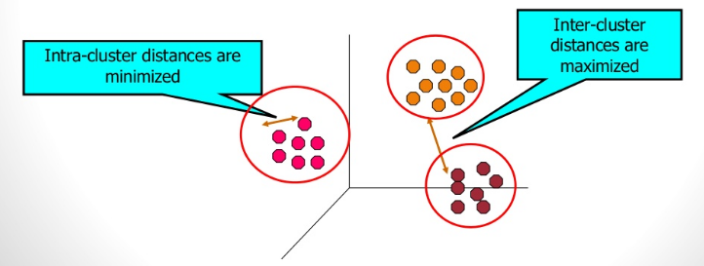
The greater the similarity (homogeneity) within a group and the greater the difference between groups, the better and more distinct the clustering is

Slide 10
Defining Similarity Using Distance
We have used the K-Nearest Neighbor approach multiple times without formally describing how the algorithm determines which observations are the k-nearest neighbors.
Now, we explicitly define and extend nearest neighbor thinking to create a procedure for clustering observations
To measure similarity between two observations, we use a distance measure

Slide 11
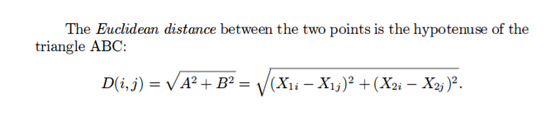
Distance & Clustering
Clustering methods require a more precise definition of “similarity”
In this case, a “closeness” or “proximity”
Measured in Euclidean Distance

Slide 12
Distance
"Distance" measures the dissimilarity between two data observations, say
a = (a₁; a₂; : : : ; a_{n}) and b = (b₁; b₂; : : : ; b_{n}).
A distance measure should satisfy the following requirements:
d(a; b) >= 0 distance is non-negative
d(a; a) = 0 distance to itself is 0
d(a; b) = d(b; a) distance is symmetric
d(a; b) < d(a; c)+d(c; b) triangular inequality

Slide 13
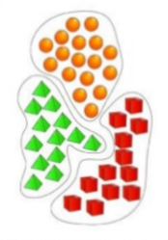
Major Clustering Approaches
Partitional Clustering
A division of the set of data objects into non-overlapping subsets (clusters) such that each data object is in exactly one subset
Construct various partitions and then evaluate them by some criterion
A fixed number of clusters, k, is generated
Start with an initial (perhaps random) cluster
Examples of Partitioning Algorithms:
Kmeans, PAM, CLARA, FANNY

Slide 14
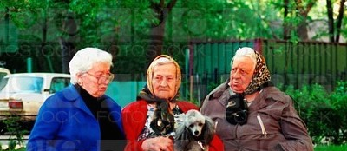
PAM, CLARA, FANNY
FANNY
PAM
CLARA

Slide 15
Overview of Partitioning Algorithms
PAM: Partition Around Medoids
PAM is intended to find a sequence of objects (medoids) that are centrally located in clusters. Objects tentatively defined as medoids are placed into a set S of selected objects. If O is the set of objects that the set U = O - S is the set of unselected objects.
Two Step Algorithm:
BUILD: A collection of k objects are selected for initial set S
SWAP: One tries to improve the quality of clustering by exchanging the selected objects (in S) with unselected objects (in U)
Goal: To minimize the average dissimilarity of objects to their closest selected object
Notes:
http://www.cs.umb.edu/cs738/pam1.pdf

Slide 16
Overview of Partitioning Algorithms
CLARA: Clustering Large Applications
Clara is a method used to deal with much larger data sets in order to reduce computing time and RAM storage problems.
Split data sets randomly into multiple subsets with a fixed size
Compute the PAM algorithm on each subset and choose the corresponding k representative objects (medoids). Assign each observation of the entire dataset to the nearest medoid.
Calculate the mean (or sum) of the dissimilarities of the observations to their closest medoid. This is used as a measure of the goodness of the clustering.
Retain the sub-dataset for which the mean (or sum) is minimal. A further analysis is carried out on final partition
Notes:
http://www.sthda.com/english/wiki/partitioning-cluster-analysis-quick-start-guide-unsupervised-machine-learning#concept-2

Slide 17
Overview of Partitioning Algorithms
FANNY: Fuzzy Analysis Clustering
Unlike K-Means and PAM, there is a type of clustering known as fuzzy clustering. Fuzzy clustering is considered soft clustering, in which each element has a probability of belonging to each cluster.
Each element has a set of membership coefficients corresponding to the degree of being in a given cluster
Points close to the center of a cluster, may be in the cluster to a higher degree than points in the edge of a cluster. The degree, to which an element belongs to given cluster, is a numerical value in [0, 1]
FANNY = A fuzzy clustering method, which gives a degree for memberships to the clusters for all objects.
Notes:
http://www.sthda.com/english/wiki/fuzzy-clustering-analysis-unsupervised-machine-learning
http://users.jyu.fi/~samiayr/pdf/introtoclustering_report.pdf

Slide 18
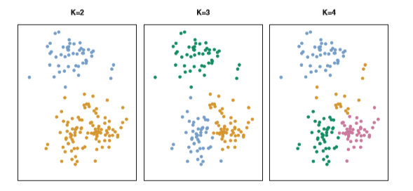
K-Means Clustering

Slide 19
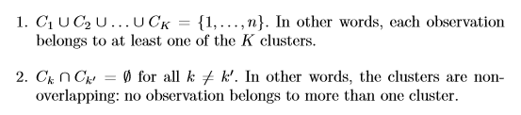
The Algorithm - Formal Definition
Start by partitioning observations into subsets

Slide 20

The Algorithm - Formal Definition
Minimize the within cluster variation, W(C_{k})

Slide 21

The Algorithm - Formal Definition
Define within cluster variation as squared Euclidian distance divided by the number of observations in the cluster

Slide 22

The Algorithm - Formal Definition
Full Formulation - minimize the sum of within cluster variation over all K clusters

Slide 23
The Algorithm - Overview
Given k, the k-means algorithm is implemented in 4 steps
Randomly partition observations into k nonempty subsets
Compute seed points as the centroids of the clusters of the current partition. The centroid is the center (mean point) of the cluster – it isn't (necessarily) an observation in the cluster.
Assign each observation to the cluster with the nearest center.
Go back to Step 2 unless no observations change clustering.

Slide 24
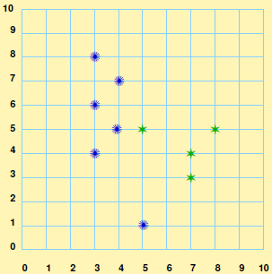
K-Means Clustering Example
2 - variable example (k=2)

Slide 25
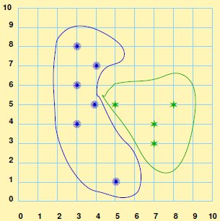
K-Means Clustering Example
Select an initial (random) set of k clusters.

Slide 26
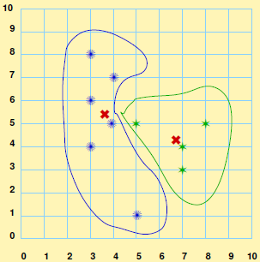
K-Means Clustering Example
Compute the center of each cluster
Note that the "center" of the cluster is not (necessarily) one of the original points

Slide 27
K-Means Clustering Example
Reassign points to the closest center

Slide 28
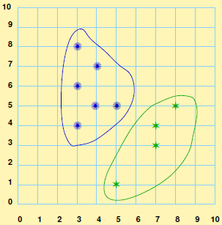
K-Means Clustering Example
And form new clusters based on the assignment

Slide 29
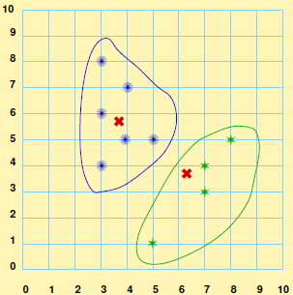
K-Means Clustering Example
Recalculate the centers of the new clusters

Slide 30
K-Means Clustering Example
Reassign all points to the new clusters

Slide 31
K-Means Clustering Example
Repeat until no observations change clusters, then stop

Slide 32
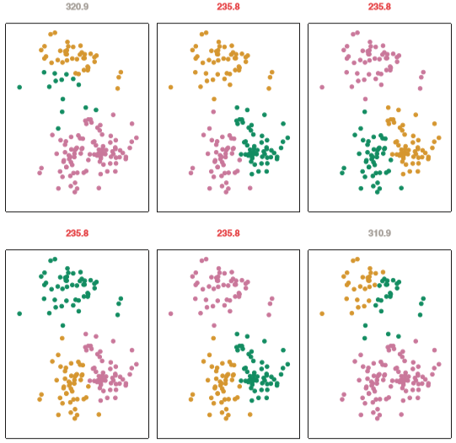
Interpreting the Result
The algorithm is not guaranteed to reach the global minimum

Slide 33
Choosing k
The problem of selecting K is far from simple. This issue, along with other practical considerations that arise in performing K-means clustering, is addressed in Section 10.3.3

Slide 34
Let’s get moving!
Interactive Clustering Activity

Slide 35
K-Means Clustering
Overall Population

Slide 36
K-Means Clustering
Fix the number of Clusters

Slide 37
K-Means Clustering
Calculate distance of each case from all clusters

Slide 38
K-Means Clustering
Assign each case to nearest cluster

Slide 39
K-Means Clustering
Recalculate the cluster centers

Slide 40
K-Means Clustering
Calculate distance of each case from all clusters

Slide 41
K-Means Clustering
Assign case to cluster
Recalculate cluster center
Move to next case

Slide 42
K-Means Clustering
Assign case to cluster (yellow)
Recalculate cluster center
Move to next case

Slide 43
K-Means Clustering
Assign case to cluster (green)
Recalculate cluster center

Slide 44
K-Means Clustering
Re-assess distance to cluster centers for previous cases

Slide 45
K-Means Clustering
Adjust clusters to new centers (yellow becomes green)
Recalculate Centers

Slide 46
K-Means Clustering
Calculate distance of each case from all clusters

Slide 47
K-Means Clustering
Calculate center of red cluster

Slide 48
K-Means Clustering
Continue until there is no significant change between two iterations

Slide 49
K-Means Clustering
Depending on where the original k is, we could end with different clusters

Slide 50
K-Means Clustering
Depending on where the original k is, we could end with different clusters

Slide 51
Lab 1: Introduction to K-means in R

Slide 52
Lab 2: Further Review of K-means and Examples of Applications

Slide 53
Questions?
Comments?
Concerns?

